Slide 1
ConvNeXt Block 2022
RepNeXt Block Training-time
Our Block Inference-time
dim-chan
dim-chan
dim-chan
DwConv 7×7 dim
DwConv
3×3 dim/3
DwConv
5×5 dim/3
DwConv
7×7 dim/3
GConv 7×7
dim×2 Group=dim
LN
BN
Conv 1×1 4×dim
GELU
Conv 1×1 4×dim
Conv 1×1 5×dim
GELU
GELU
GELU
Conv 1×1 dim
Conv 1×1 dim
Conv 1×1 dim

Slide 2
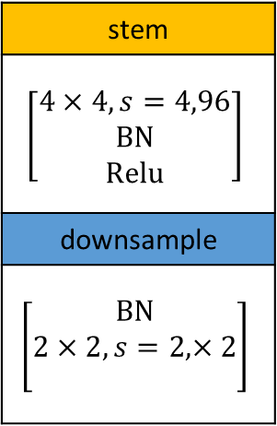
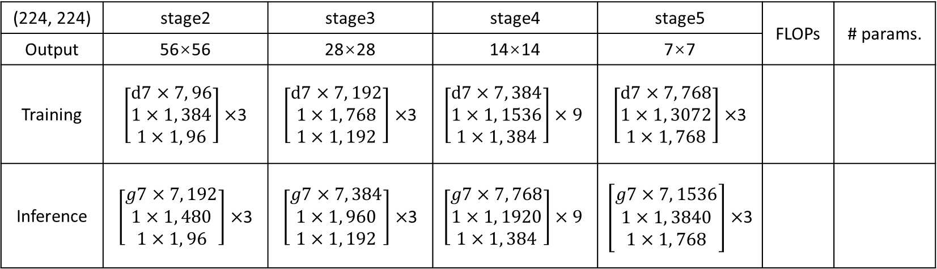
(224, 224) | stage2 | stage3 | stage4 | stage5 | FLOPs | # params.
Output | 56×56 | 28×28 | 14×14 | 7×7
Training | $\left[\begin{aligned}d7×7, 96 \\ 1×1, 384 \\ 1×1, 96\end{aligned}\right]×$3 | $\left[\begin{aligned}d7×7, 192 \\ 1×1, 768 \\ 1×1, 192\end{aligned}\right]×$3 | $$\left[\begin{aligned}d7×7, 384 \\ 1×1, 1536 \\ 1×1, 384\end{aligned}\right]×9$$ | $\left[\begin{aligned}d7×7, 768 \\ 1×1, 3072 \\ 1×1, 768\end{aligned}\right]×$3
Inference | $\left[\begin{aligned}g7×7, 192 \\ 1×1, 480 \\ 1×1, 96\end{aligned}\right]×$3 | $\left[\begin{aligned}g7×7, 384 \\ 1×1, 960 \\ 1×1, 192\end{aligned}\right]×$3 | $$\left[\begin{aligned}g7×7, 768 \\ 1×1, 1920 \\ 1×1, 384\end{aligned}\right]×9$$ | $\left[\begin{aligned}g7×7, 1536 \\ 1×1, 3840 \\ 1×1, 768\end{aligned}\right]×$3
stem
$$\left[\begin{aligned}4×4, s=4,96 \\ BN \\ Relu\end{aligned}\right]$$
downsample
$$\left[\begin{aligned}BN \\ 2×2, s=2,×2 \\ \end{aligned}\right]$$

Slide 3
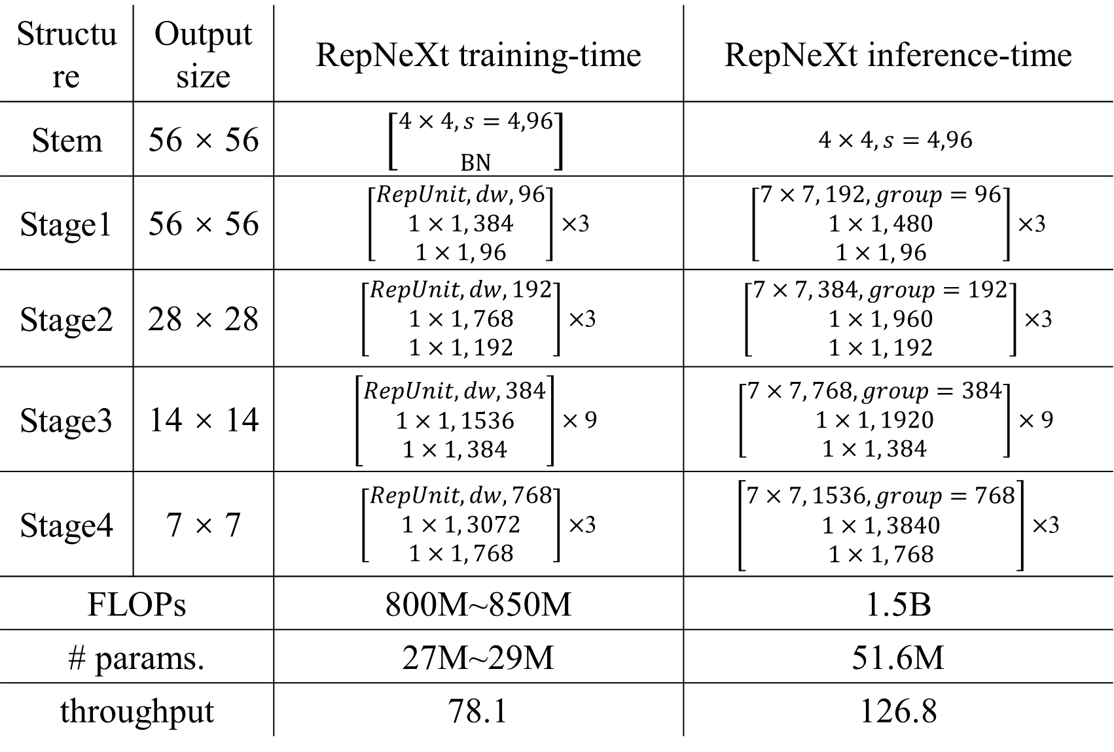
Structure | Output size | RepNeXt training-time | RepNeXt inference-time
Stem | 56 × 56 | $$\left[\begin{aligned}4×4, s=4,96 \\ BN\end{aligned}\right]$$ | $$4×4, s=4,96$$
Stage1 | 56 × 56 | $\left[\begin{aligned}RepUnit,dw, 96 \\ 1×1, 384 \\ 1×1, 96\end{aligned}\right]×$3 | $\left[\begin{aligned}7×7, 192,group=96 \\ 1×1, 480 \\ 1×1, 96\end{aligned}\right]×$3
Stage2 | 28 × 28 | $\left[\begin{aligned}RepUnit,dw, 192 \\ 1×1, 768 \\ 1×1, 192\end{aligned}\right]×$3 | $\left[\begin{aligned}7×7, 384,group=192 \\ 1×1, 960 \\ 1×1, 192\end{aligned}\right]×$3
Stage3 | 14 × 14 | $$\left[\begin{aligned}RepUnit,dw, 384 \\ 1×1, 1536 \\ 1×1, 384\end{aligned}\right]×9$$ | $$\left[\begin{aligned}7×7, 768,group=384 \\ 1×1, 1920 \\ 1×1, 384\end{aligned}\right]×9$$
Stage4 | 7 × 7 | $\left[\begin{aligned}RepUnit,dw, 768 \\ 1×1, 3072 \\ 1×1, 768\end{aligned}\right]×$3 | $\left[\begin{aligned}7×7, 1536,group=768 \\ 1×1, 3840 \\ 1×1, 768\end{aligned}\right]×$3
FLOPs |  | 800M~850M | 1.5B
# params. |  | 27M~29M | 51.6M
throughput |  | 78.1 | 126.8

Slide 4
RepNeXt Block Training-time
RepNeXt Block Training-time
RepNeXt Block Training-time
Our Block Inference-time
dim-chan
dim
dim
dim-chan
DwConv
3×3 dim/3
DwConv
5×5 dim/3
DwConv
7×7 dim/3
DwConv
3×3 dim/3
DwConv
5×5 dim/3
DwConv
7×7 dim/3
DwConv
3×3 dim BN
DwConv
5×5 dim BN
DwConv
7×7 dim BN
GConv 7×7
dim×2 Group=dim
BN
Concat
GELU
Conv 1×1 4×dim
GELU
BN; Conv 1×1 4×dim; GELU
GELU
Conv 1×1 4×dim; GELU
Conv 1×1 5×dim
GELU
GELU
Conv 1×1 dim
Conv 1×1 dim
Conv 1×1 dim
Conv 1×1 dim

Slide 5
ConvNeXt Block 2022
ConvNeXt-ERep Block
RepNeXt Block Training-time
RepNeXt Block Inference-time
dim
dim
dim
dim
DwConv 7×7 dim;
LayerNorm
DwConv 7×7 dim;
BatchNorm
RepUnit dim
(DWConv 7×7)
GwConv 7×7
Group=dim 2×dim
PWConv(FC) 4×dim;
GELU
GELU
PWConv 4×dim;
GELU
GELU
PWConv 4×dim;
GELU
PWConv 5×dim;
GELU
PWConv(FC) dim
PWConv dim
PWConv dim
PWConv dim

Slide 6
dim
dim
dim
DwConv 7×7 dim;
LayerNorm
RepUnit dim
(DWConv 7×7)
GwConv 7×7
Group=dim 2×dim
PWConv(FC) 4×dim;
GELU
GELU
PWConv 4×dim;
GELU
PWConv 5×dim;
GELU
PWConv(FC) dim
PWConv dim
PWConv dim

Slide 7
dim
dim
RepUnit
(DWConv 7×7)
GwConv 7×7
Group=dim
dim
2×dim
GELU
PwConv; GELU
PwConw; GELU
4×dim
5×dim
PwConv
PwConv
dim
dim

Slide 8
ConvNeXt-ERep Block
dim
DwConv 7×7 dim;
BatchNorm
GELU
PWConv 4×dim;
GELU
PWConv dim

Slide 9
dim
dim
dim
DwConv
3×3 dim/3
DwConv
5×5 dim/3
DwConv
7×7 dim/3
DwConv
3×3 dim BN
DwConv
5×5 dim BN
DwConv
7×7 dim BN
DwConv
3×1 dim BN
DwConv
1×5 dim BN
DwConv
7×7 dim BN
Concat
BN
DwConv
7×7 dim/3
fuse BN
×dim
fuse BN
×dim
DwConv
7×7 dim
DwConv
7×7 dim
DwConv
5×5 dim/3
Pad
fuse BN
×dim
fuse BN
×dim
DwConv
5×5 dim
Pad
DwConv
1×5 dim
Pad
Add
Add
Pad
fuse BN
×dim
fuse BN
×dim
DwConv
3×3 dim/3
Concat
DwConv
3×3 dim
DwConv
3×1 dim
fuse BN
Pad
Pad

Slide 10
dim
dim
dim
DwConv
3×3 dim/3
DwConv
5×5 dim/3
DwConv
7×7 dim/3
DwConv
3×3 dim BN
DwConv
5×5 dim BN
DwConv
7×7 dim BN
DwConv
3×1 dim BN
DwConv
1×5 dim BN
DwConv
7×7 dim BN
Concat
BN
DwConv
7×7 dim/3
fuse BN
×dim
fuse BN
×dim
DwConv
7×7 dim
DwConv
7×7 dim
DwConv
5×5 dim/3
Pad
fuse BN
×dim
fuse BN
×dim
DwConv
5×5 dim
Pad
DwConv
1×5 dim
Pad
Add
Add
Pad
fuse BN
×dim
fuse BN
×dim
DwConv
3×3 dim/3
Concat
DwConv
3×3 dim
DwConv
3×1 dim
fuse BN
Pad
Pad

Slide 11
dim
dim
dim
DwConv
3×3 dim/3
DwConv
5×5 dim/3
DwConv
7×7 dim/3
DwConv
3×3 dim BN
DwConv
5×5 dim BN
DwConv
7×7 dim BN
DwConv
3×1 dim BN
DwConv
1×5 dim BN
DwConv
7×7 dim BN
Concat
BN
DwConv
7×7 dim/3
fuse BN
×dim
fuse BN
×dim
DwConv
7×7 dim
DwConv
7×7 dim
DwConv
5×5 dim/3
Pad
fuse BN
×dim
fuse BN
×dim
DwConv
5×5 dim
Pad
DwConv
1×5 dim
Pad
Add
Add
Pad
fuse BN
×dim
fuse BN
×dim
DwConv
3×3 dim/3
Concat
DwConv
3×3 dim
DwConv
3×1 dim
fuse BN
Pad
Pad

Slide 12
dim
dim
dim
DwConv
3×3 dim/3
DwConv
5×5 dim/3
DwConv
7×7 dim/3
DwConv
3×3 dim BN
DwConv
5×5 dim BN
DwConv
7×7 dim BN
DwConv
3×1 dim BN
DwConv
1×5 dim BN
DwConv
7×7 dim BN
Concat
BN
DwConv
7×7 dim/3
fuse BN
×dim
fuse BN
×dim
DwConv
7×7 dim
DwConv
7×7 dim
DwConv
5×5 dim/3
Pad
fuse BN
×dim
fuse BN
×dim
DwConv
5×5 dim
Pad
DwConv
1×5 dim
Pad
Add
Add
Pad
fuse BN
×dim
fuse BN
×dim
DwConv
3×3 dim/3
Concat
DwConv
3×3 dim
DwConv
3×1 dim
fuse BN
Pad
Pad

Slide 13
dim
DwConv
3×1 dim BN
DwConv
1×5 dim BN
DwConv
7×7 dim BN
fuse BN
×dim
DwConv
7×7 dim
fuse BN
×dim
DwConv
1×5 dim
Padding
Add
fuse BN
×dim
DwConv
3×1 dim
Padding

Slide 14














$${pw}_{1}$$
$$a(I_{2})$$
$$I_{0}$$
$$I_{1}$$
$${pw}_{2}$$
$$O$$
$$dw$$
A
A
$${pw}_{1}^{rep}$$
$$a(I_{2}^{rep})$$
$${gw}^{rep}$$
$$I_{1}^{rep}$$
$${pw}_{2}^{rep}$$
$$I_{0}$$
$$O^{rep}$$
A
Non-all-zero Dirac Initialized Weight
Full Zero Weight
Original Feature Map
Activated Original Feature Map

Slide 15

















$${pw}_{1}$$
$$a(I_{2})$$
$$I_{0}$$
$$I_{1}$$
$${pw}_{2}$$
$$O$$
$$dw$$
$$a$$
$$a$$
$${pw}_{1}^{rep}$$
$$a(I_{2}^{rep})$$
$${gw}^{rep}$$
$$I_{1}^{rep}$$
$${pw}_{2}^{rep}$$
$$I_{0}$$
$$O^{rep}$$
$$a$$
Dirac Initialized Weight
Full Zero Weight
Original Feature Map
Activated Original Feature Map

Slide 16
$${pw}_{1}$$
$$a(I_{2})$$
$$I_{0}$$
$$I_{1}$$
$${pw}_{2}$$
$$O$$
$$dw$$
$$a$$
$$a$$
$${pw}_{1}^{rep}$$
$$a(I_{2}^{rep})$$
$${gw}^{rep}$$
$$I_{1}^{rep}$$
$${pw}_{2}^{rep}$$
$$I_{0}$$
$$O^{rep}$$
$$a$$
Dirac Initialized Weight
Full Zero Weight
Original Feature Map
Activated Original Feature Map

Slide 17














$${pw}_{1}$$
$$a(I_{2})$$
$$I_{0}$$
$$I_{1}$$
$${pw}_{2}$$
$$O$$
$$dw$$
A
A
$${pw}_{1}^{rep}$$
$$a(I_{2}^{rep})$$
$${gw}^{rep}$$
$$I_{1}^{rep}$$
$${pw}_{2}^{rep}$$
$$I_{1}$$
$$O^{rep}$$
A
Dirac Initialized Weight
Full Zero Weight
Original Feature Map
Activated Original Feature Map

Slide 18










$${pw}_{1}$$
$$a(I_{2})$$
$$I_{0}$$
$$I_{1}$$
$${pw}_{2}$$
$$O$$
$$dw$$
A
A
$${pw}_{1}^{rep}$$
$$a(I_{2}^{rep})$$
$${gw}^{rep}$$
$$I_{1}^{rep}$$
$${pw}_{2}^{rep}$$
$$O^{rep}$$
A
Dirac Initialized Weight
Full Zero Weight
Original Feature Map
Activated Original Feature Map
$$I_{12345}$$

